Slide 1


Slide 2
Topics for Today
Handwritten Digits using Neural networks
Support Vector machines
Notes:
In London

Slide 3
Handwritten digits classification
Our training data for the network will consist of many 28 X 28 pixel images of scanned handwritten digits, and so the input layer contains 784=28×28 neurons
The input pixels are greyscale, with a value of 0.0 representing white, a value of 1.0 representing black, and in between values representing gradually darkening shades of grey
The example shown illustrates a small hidden layer, containing just n=15 neurons
The output layer of the network contains 10 neurons. If the first neuron fires, i.e., has an output ≈1≈1, then that will indicate that the network thinks the digit is a 0. If the second neuron fires then that will indicate that the network thinks the digit is a 1
Notes:
In London

Slide 4
Support Vector Machine
Notes:
In London

Slide 5
Intuition
Think of machine learning algorithms as an armory packed with axes, sword, blades, bow, dagger etc.
You have various tools, but you ought to learn to use them at the right time
As an analogy, think of ‘Regression’ as a sword capable of slicing and dicing data efficiently, but incapable of dealing with highly complex data
On the contrary, ‘Support Vector Machines’ is like a sharp knife – it works on smaller datasets, but on them, it can be much more stronger and powerful in building models.
Notes:
In London

Slide 6
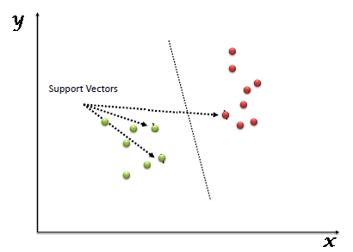
What is SVM
“Support Vector Machine” (SVM) is a supervised machine learning algorithm, it is mostly used in classification problems
In this algorithm, we plot each data item as a point in n-dimensional space (where n is number of features you have) with the value of each feature being the value of a particular coordinate
Then, we perform classification by finding the hyper-plane that differentiate the two classes very well (look at the below snapshot).
Support Vectors are simply the co-ordinates of individual observation
Support Vector Machine is a frontier which best segregates the two classes (hyper-plane/ line).
Notes:
In London

Slide 7
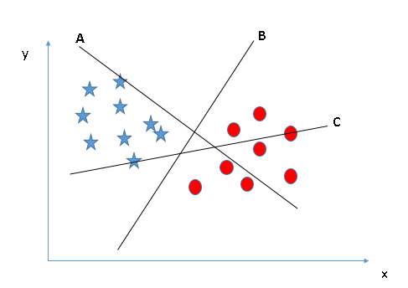
Which is the right Hyperplane
Notes:
In London

Slide 8
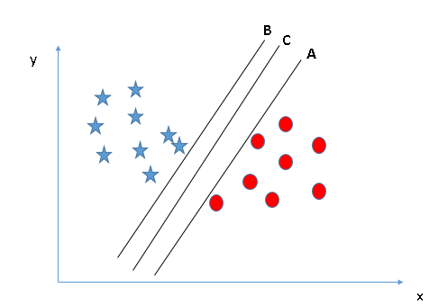
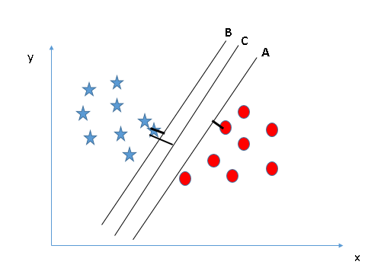
Here, maximizing the distances between nearest data point (either class) and hyper-plane will help us to decide the right hyper-plane. This distance is called as Margin
If we select a hyper-plane having low margin then there is high chance of miss-classification.
Notes:
In London

Slide 9
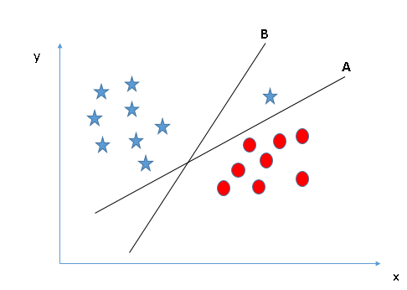
Which is the right Hyperplane
Notes:
In London

Slide 10
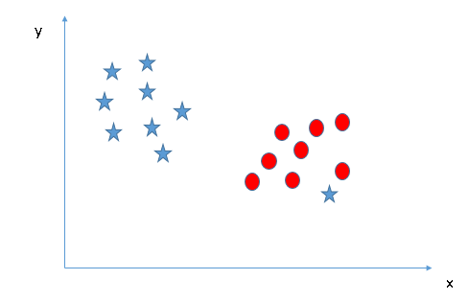
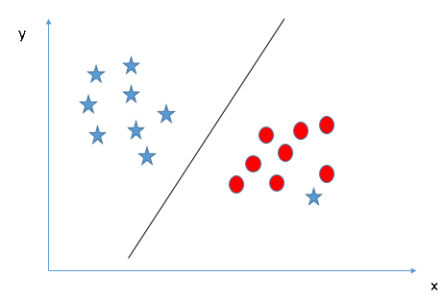
SVM has a feature to ignore outliers and find the hyper-plane that has maximum margin. Hence, we can say, SVM is robust to outliers.
Notes:
In London

Slide 11
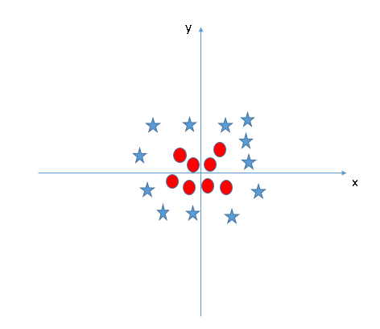
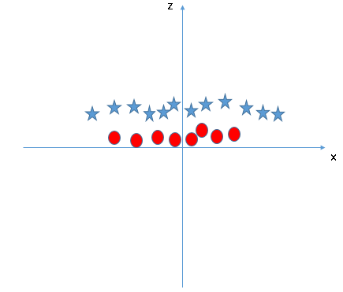
Can we have a linear line/hyperplane
SVM can solve this problem. Easily! It solves this problem by introducing additional feature. Here, we will add a new feature z=x^2+y^2. Now, let’s plot the data points on axis x and z:
We will not add the feature manually to have a hyper-plane. SVM has a technique called the kernel trick. It is mostly useful in non-linear separation problem
Notes:
In London

Slide 12
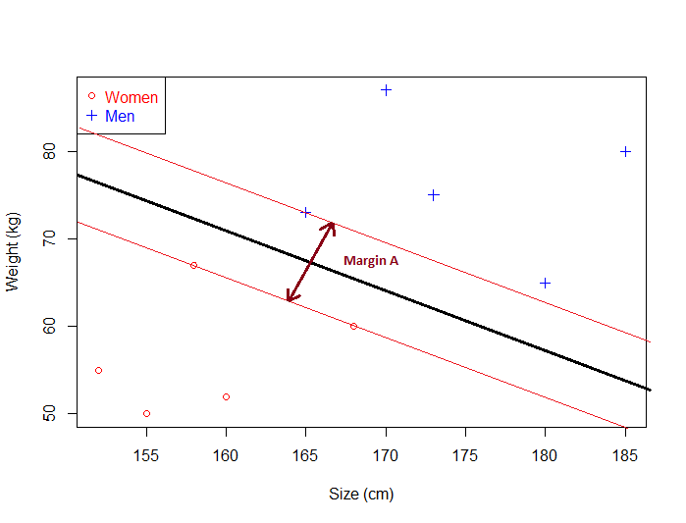
What is Margin and how does it give optimal hyperplane
Given a particular hyperplane, we can compute the distance between the hyperplane and the closest data point. Once we have this value, if we double it we will get what is called the margin
Basically the margin is a no man's land. There will never be any data point inside the margin
Notes:
In London

Slide 13
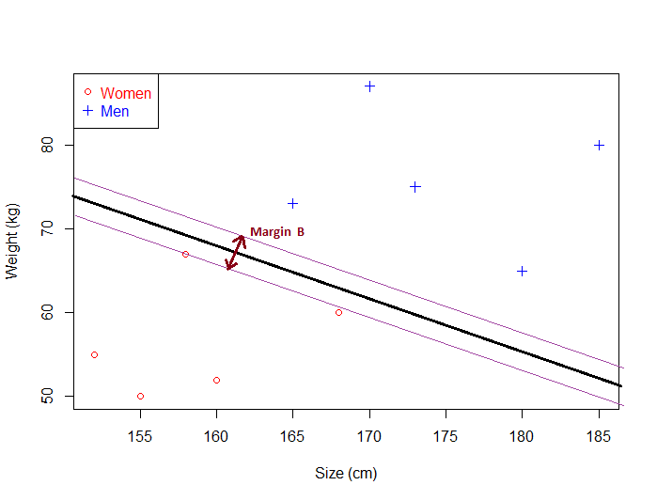
Not the best hyperplane
If an hyperplane is very close to a data point, its margin will be small.
The further an hyperplane is from a data point, the larger its margin will be.
Notes:
In London

Slide 14
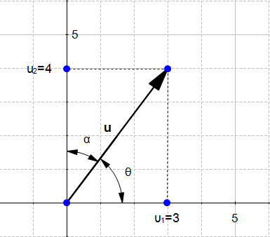
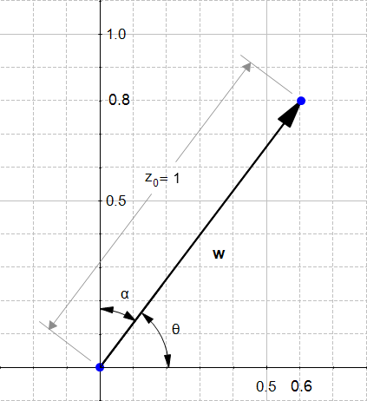
Understanding Basic Maths
The Direction
The direction of a vector u(u1,u2) is the vector w(u1/|u|,u2/|u|)
The direction of u(3,4)u(3,4) is the vector w(0.6,0.8)
Notes:
In London

Slide 15
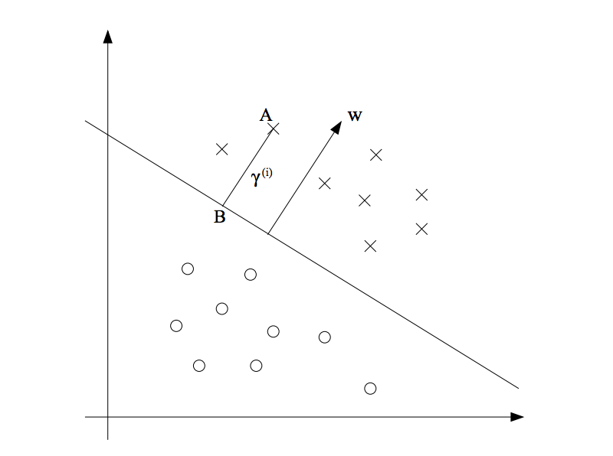


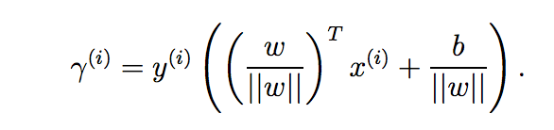
Functions and Geometric Margins
Geometric Margin
Functional Margin
This gives the sign only i.e whether the point lies on which side of the plane but not the actual distance from the plane
This gives sign and distance from the plane
Notes:
In London

Slide 16


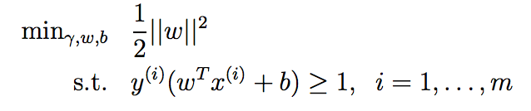
Maximize Geometric Margin
Which is equivalent to maximize
Replacing Gamma ‘ with 1
Margin = 1/|w| + 1/|w| = 2|w|
Solved using Lagrange multipliers
Notes:
In London

